Slide 1
TITLE: BLOCK CHAIN FOR SECURE NETWORKING NAME: T. Hari priya(192421223) K.Sirlakshmi(192412541)

Slide 2
BLOCKCHAIN FOR SECURE NETWORKING
INTRODUCTION 3
IMPORTANCE OF SECURE NETWORKIG 4
HOW BLOCKCHAIN ENHANCES SECURITY 5
CHALLENGES AND LIMITATIONS 6
BLOCKCHAIN IN SECURE NETWORKING 11

Slide 3
INTRODUCTION
A decentralized, distributed ledger technology that records transactions across a network of computers.
DECENTRALIZATION: No Signal Point Of Control
TRANSPARENCY: All participants have access to the same data
IMMUTABILITY: Once data is recorded, it cannot be altered

Slide 4
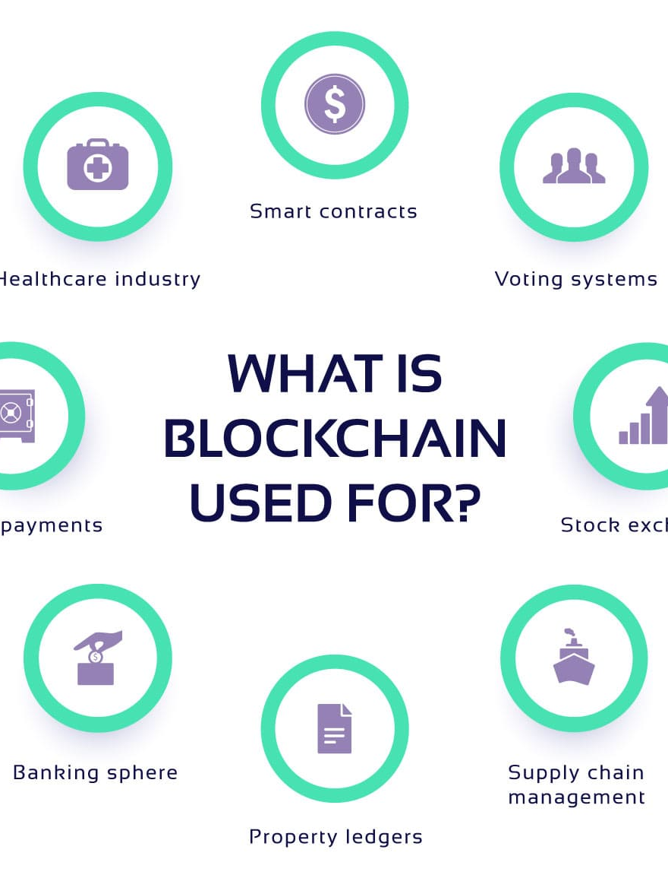
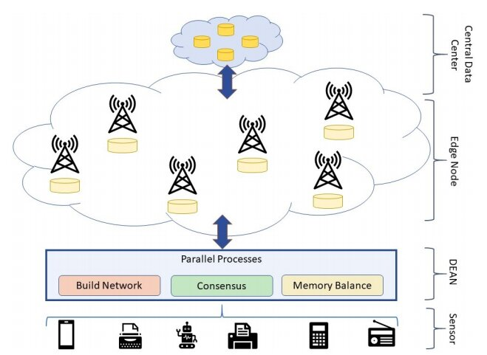
BLOCKCHAIN PROTOCOLS FOR NETWORKING

Slide 5
IMPORTANCE OF SECURE NETWORKING
EXPLAINIG SECURE NETWORKING:
Protects data integrity and privacy
Prevents unauthorized access and cyber threats
CHALLENGES IN CUREENT NETWORKING:
Centralized control and single points of failure
Vulnerability to attacks (eg: phishing)
Volume control

Slide 6

HOW BLOCKCHAIN ENHANCES SECURITY
DISTRIBURTED ARCHITECTURE:
Each participant Maintains a copy of the blockchain
Reduces Each participant maintains a risk of the single points of failure
SMART CONTRACTS:
Automated agreements that execute when the conditions are met
Reducing human error
fraud

Slide 7

CHALLENGES AND LIMITATIONS
SCALABILITY ISSUES:
Difficulty in managing a large number of transactions.
ENERGY CONSUMPTION:
high energy requirements for consensus mechanisms like proof of work .
REGULATORY CONCERNS:
LACK of clarity and standardization in many jurisdictions.

Slide 8

BLOCKCHAIN IN SECURE NETWORKING
EMERGING TECHNOLOGIES:
Integration with AI for advanced security protocols.
Interoperability between different blockchain networks
POTENTIAL IMPACTS:
Enhanced security standards
Democratization of data access and ownership.

Slide 9
THANK YOU
BRITA TAMM
502-555-0152
brita@firstupconsultants.com
www.firstupconsultants.com

